Slide 1
PEPP Trajectories Project Updates
July 17, 2025
Presented by Alyssa and Sierra to Colin, Julia, and Lindsay

Slide 2
Contents
Dropout differences between cutoff classes
18-month GMM Models for total CDSS, total SANS, LV1
Logistic Regression and Predictors of Class Membership
Comparison of Cutoff Model and GMM for total CDSS

Slide 3
GMM 18mo Outputs & Selection

Slide 4
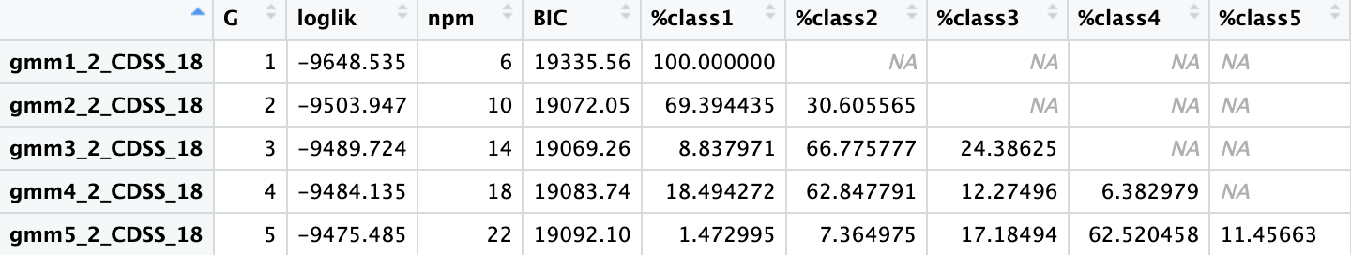
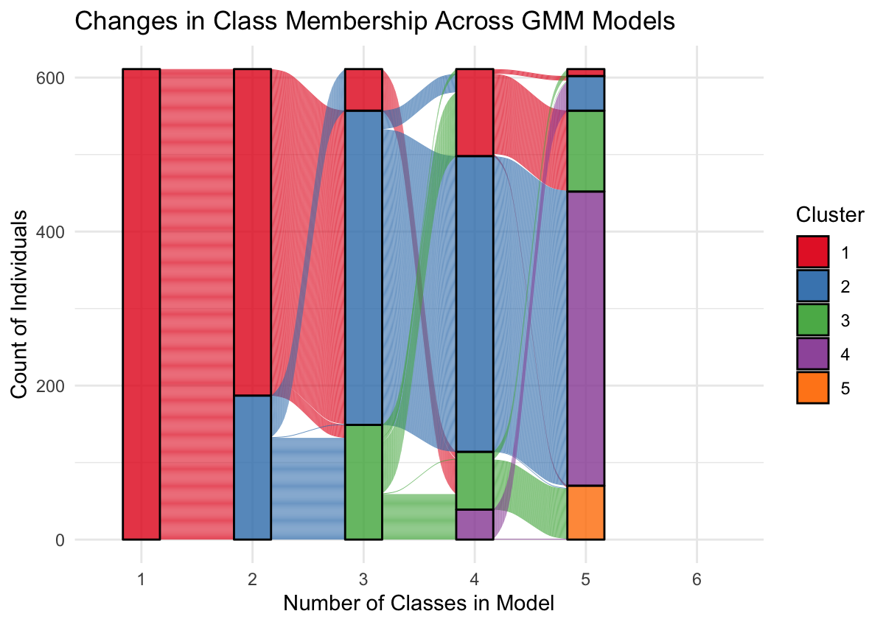
GMM2 output of Total CDSS_18mo: Tested 3-class solution (lowest BIC), 2- and 4-class solution (based on class %)

Slide 5
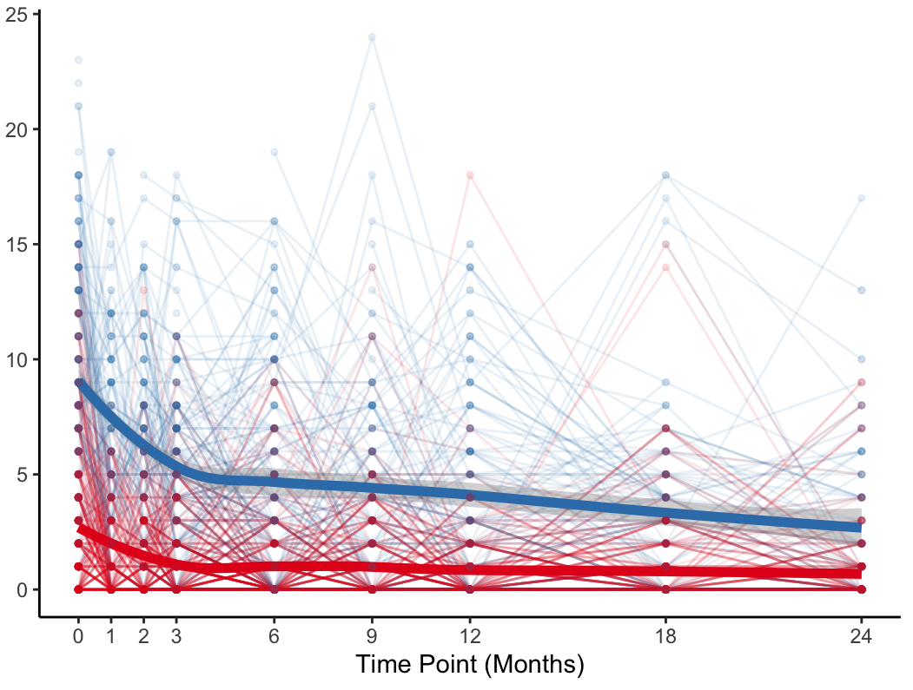
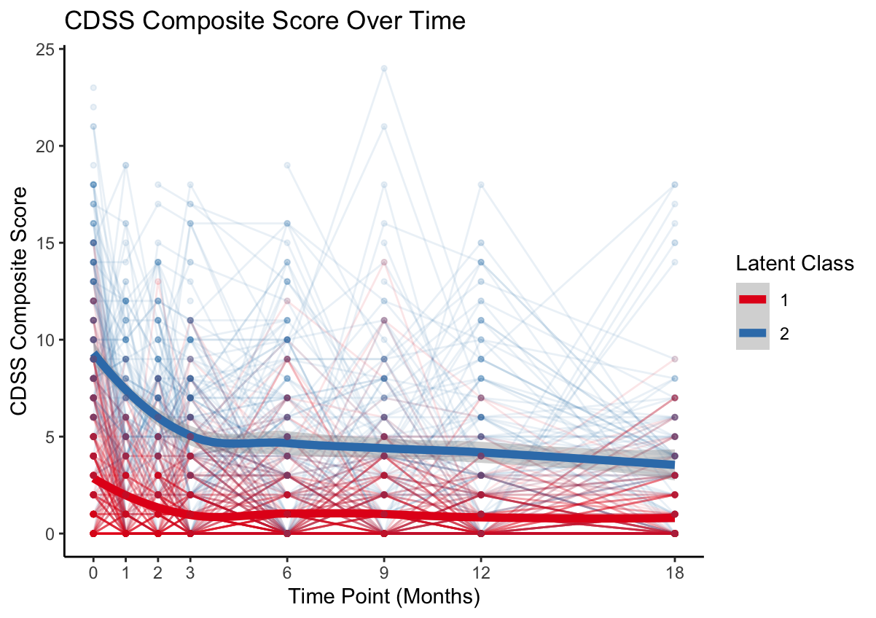
24 Months
18 Months
Total CDSS Score
Note: 2-class, GMM with random slope and intercept of Total CDSS.
Persistent low = 69%; decreasing = 31%

Slide 6
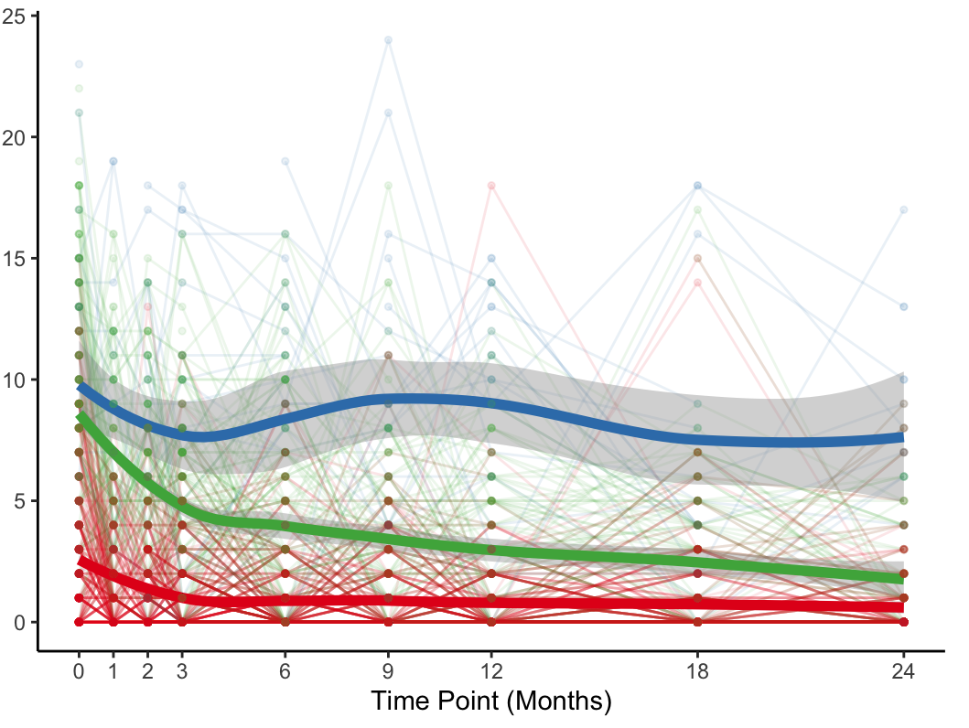
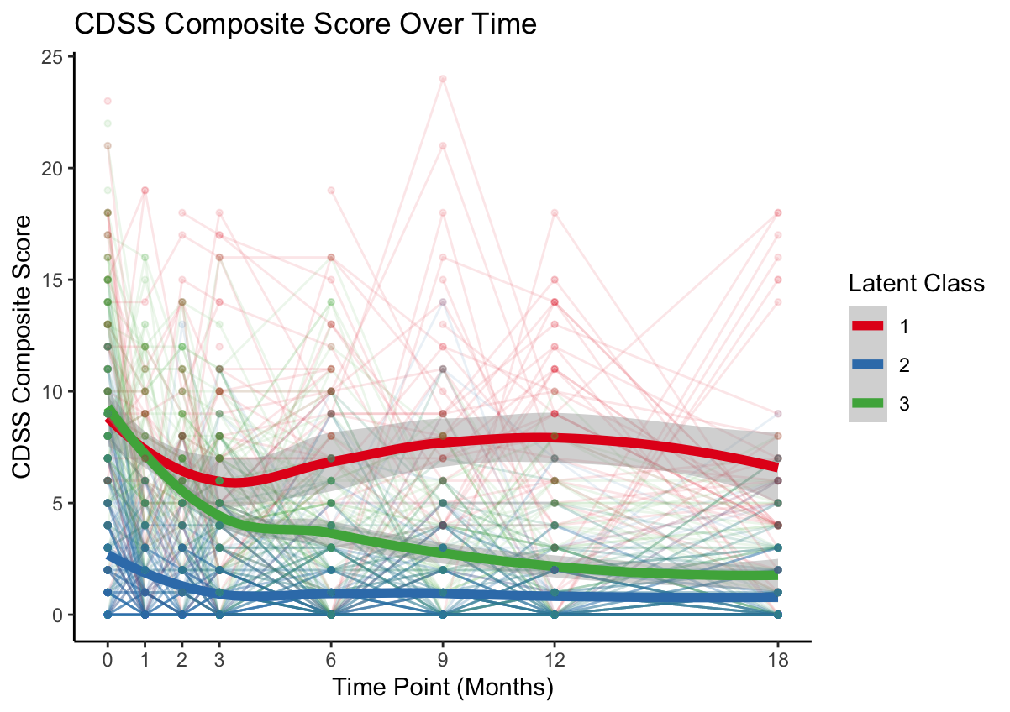
24 Months
18 Months
Total CDSS Score
Note: GMM with randomized slope and intercept
Persistent low = 66% (24mo)/67% (18mo); decreasing = 30% (24mo)/24% (18mo); fluctuating high = 4% (24mo)/9% (18mo)

Slide 7
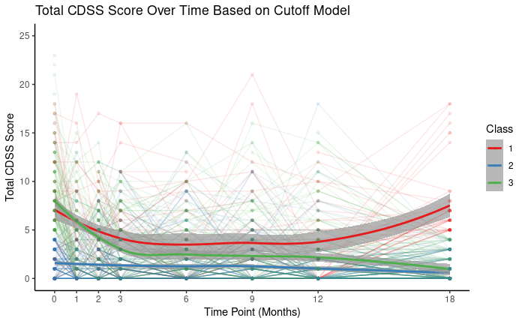
Class 1: n = 49
Class 2: n = 220
Class 3: n = 140

Slide 8
Class 1 (Persistent Depression)
Class 2 (No Depression)
45
4
68
24
196
59
Class 3 (Remitting)
Cutoff
GMM
Cutoff
GMM
100
40
42
Cutoff
GMM

Slide 9
Class 1 (Persistent Depression)
Class 2 (No Depression)
26
23
31
16
204
205
Class 3 (Remitting)
Cutoff
GMM
Cutoff
GMM
82
58
91
Cutoff
GMM

Slide 10
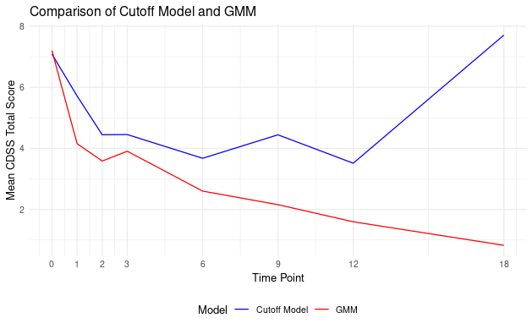
Class 1 (Persistent) Mean CDSS Scores for Participants NOT Shared Between Models
Cutoff Model: n = 45 GMM: n = 68

Slide 11
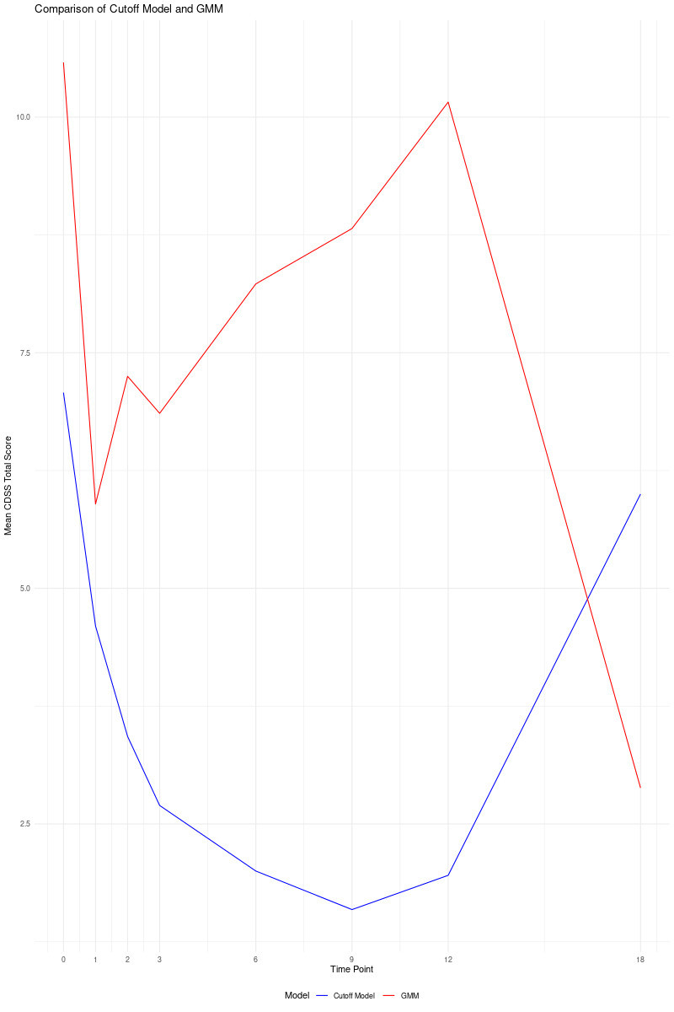
Class 1 (Persistent) Mean CDSS Scores for Participants NOT Shared Between Models
Cutoff Model: n = 45 GMM: n = 68

Slide 12
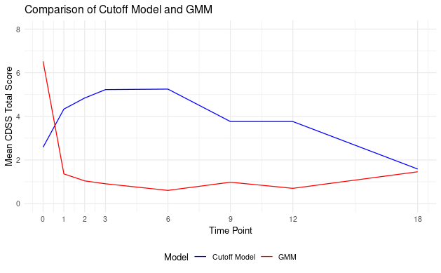
Class 2 (No Depression) Mean CDSS Scores for Participants NOT Shared Between Models
Cutoff Model: n = 24 GMM: n = 59

Slide 13
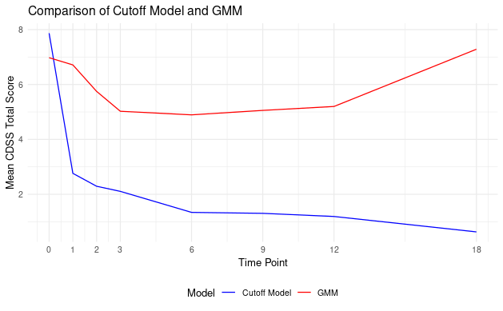
Class 3 (Remitting)Mean CDSS Scores for Participants NOT Shared Between Models
Cutoff Model: n = 100 GMM: n = 42

Slide 14
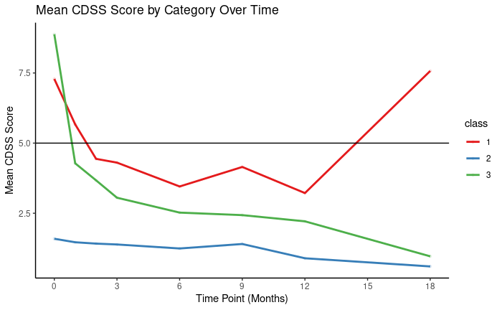

Slide 15
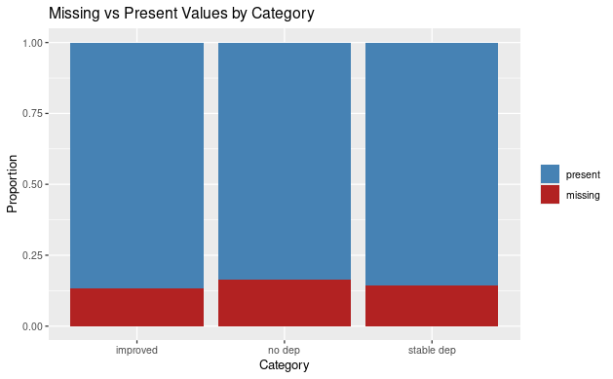

Slide 16
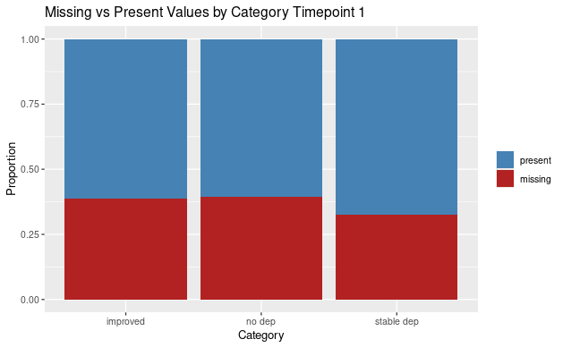
100% present at baseline

Slide 17
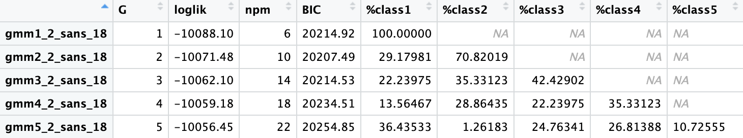
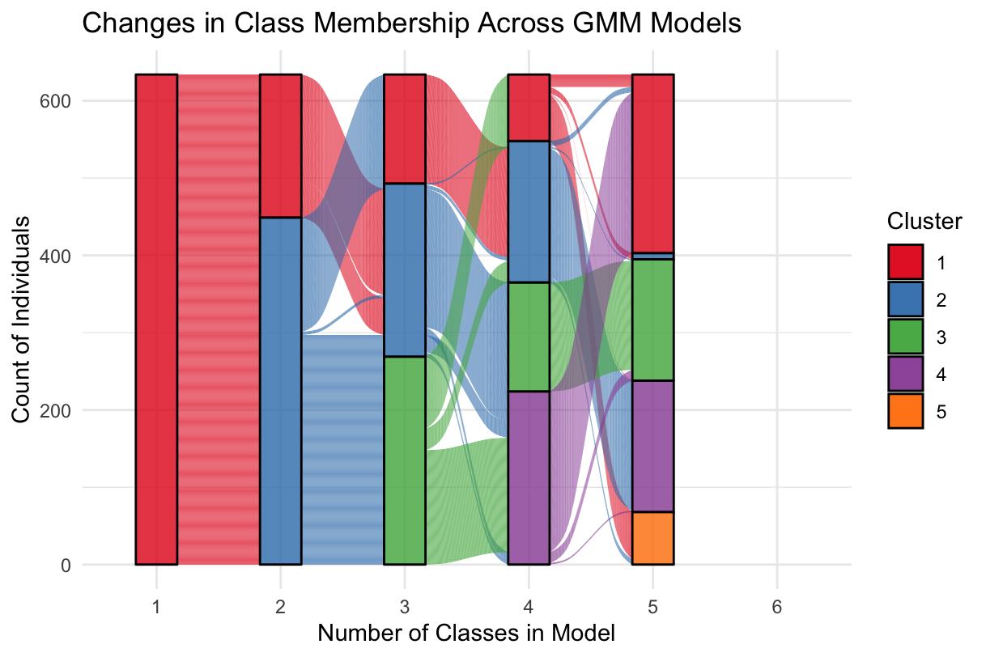
GMM2 output of Total SANS_18mo: Tested 2-class solution (lowest BIC), 3- & 4-class solution (based on class %)

Slide 18
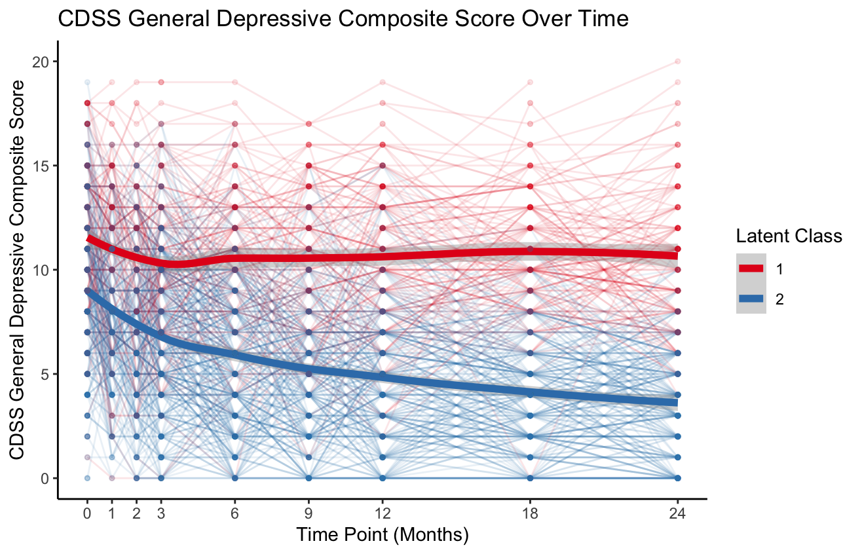
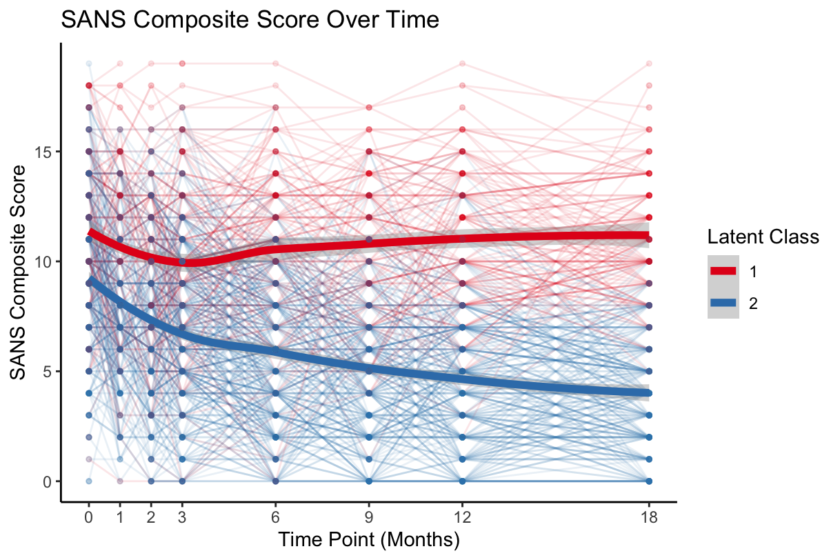
Note: 2-class, GMM2 of Total SANS (up to 24 months ) [LEFT] and (up to 18 months) [RIGHT]
Persistent high = 29%; decreasing = 71%

Slide 19
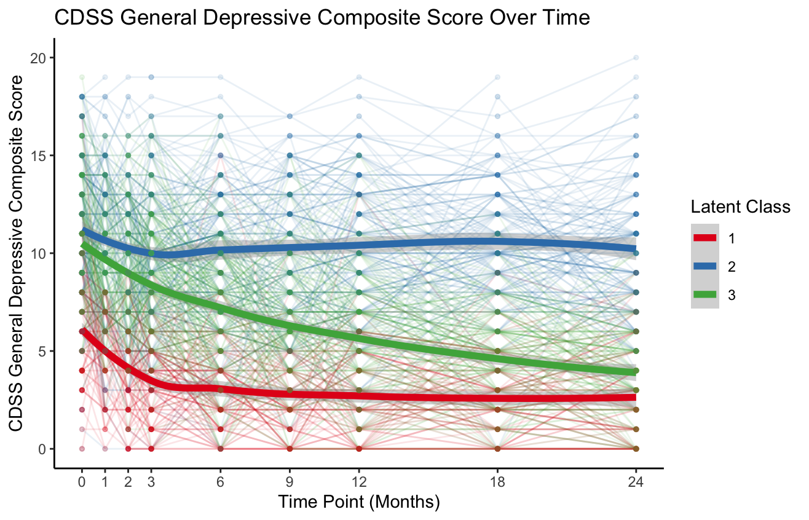
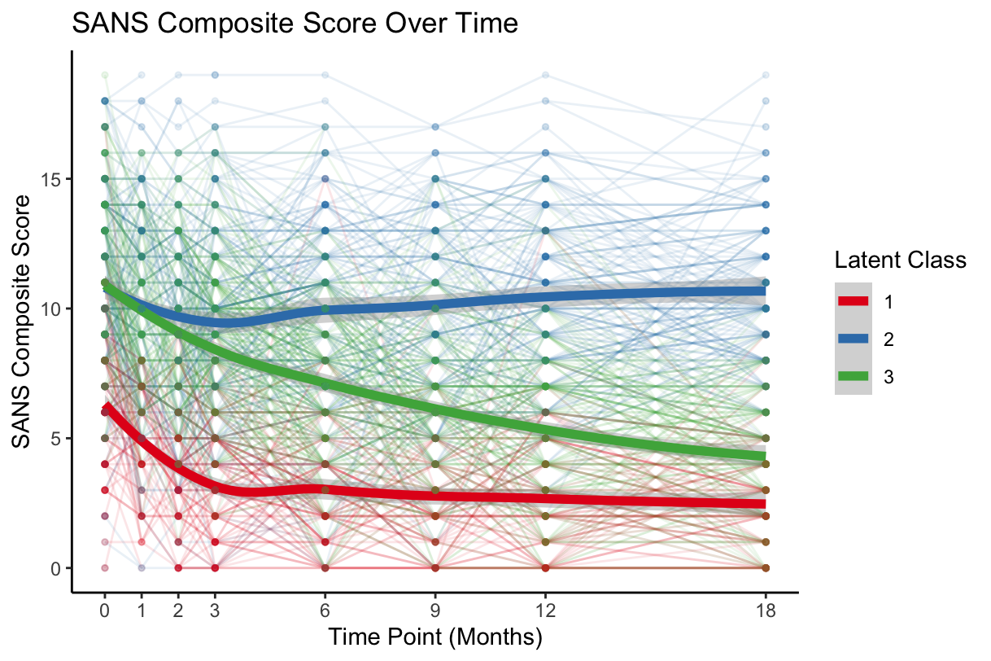
Note: 3-class, GMM2 of Total SANS (up to 24 months ) [LEFT] and (up to 18 months) [RIGHT]
Decrease/Sustained Low = 22%; persistent high = 33% (24mo)/35% (18mo); Gradual decrease = 45% (24mo)/42% (18mo)

Slide 20
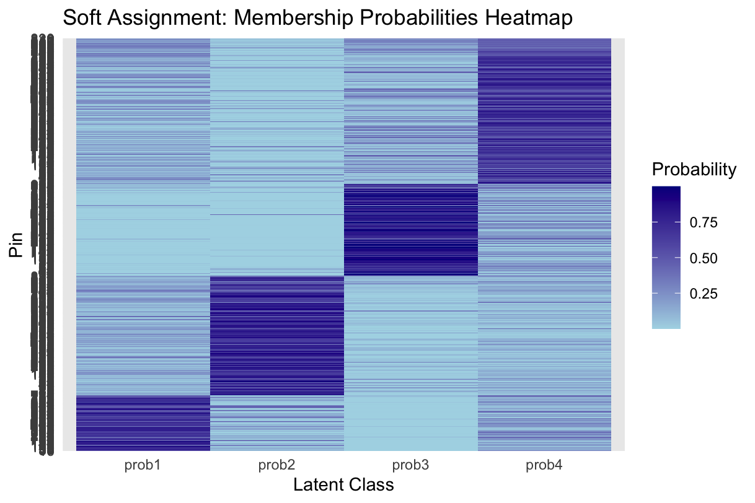
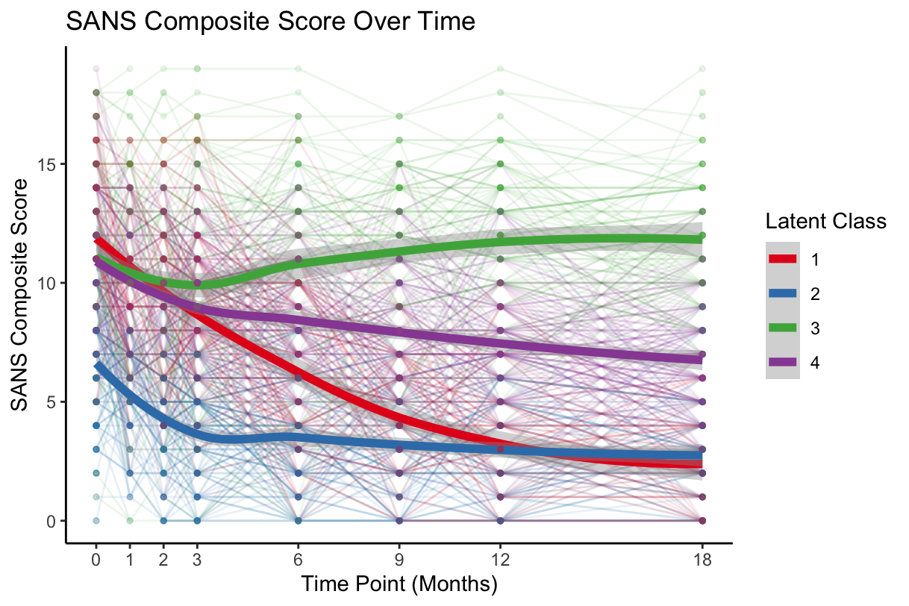
Note: 4-class, GMM2 of Total SANS (up to 18 months)
Notes:
Interesting how the starting points of Classes 1, 3, and 4 are relatively similar. Would be better to combine Classes 3 and 4
SANS Average Posterior Probabilities (4-class):
0.6855159 0.7190840 0.7997332 0.6412123

Slide 21
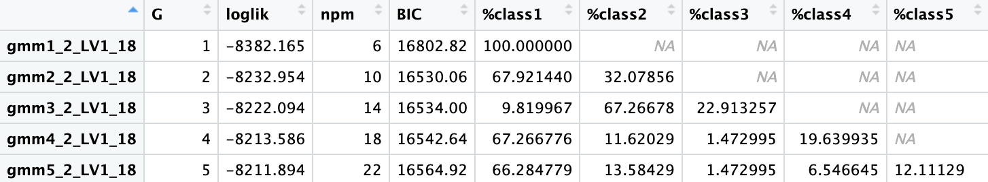
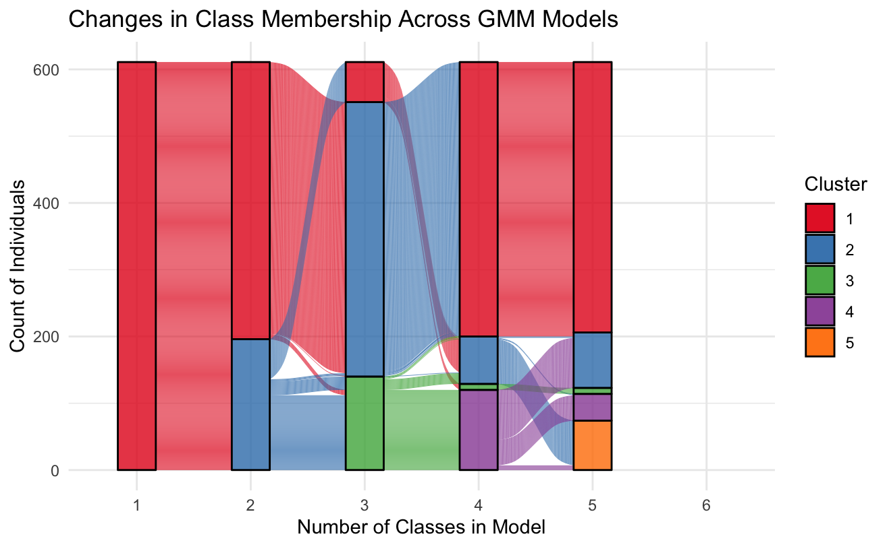
GMM2 output of Total LV1_18mo: Tested 2-class solution (lowest BIC), 3--class solution (based on class %)

Slide 22
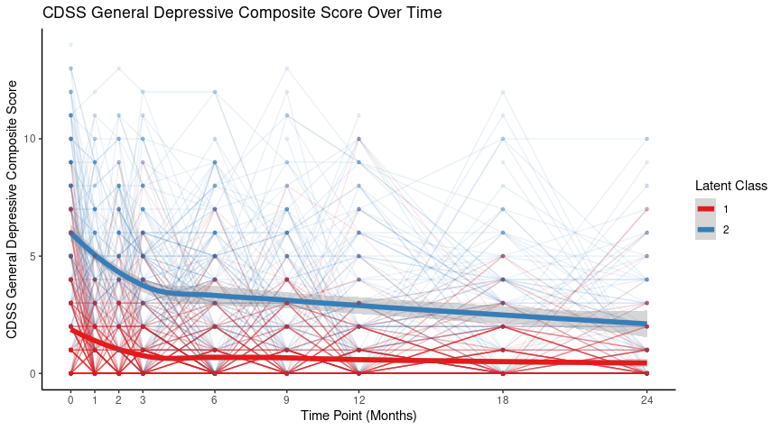
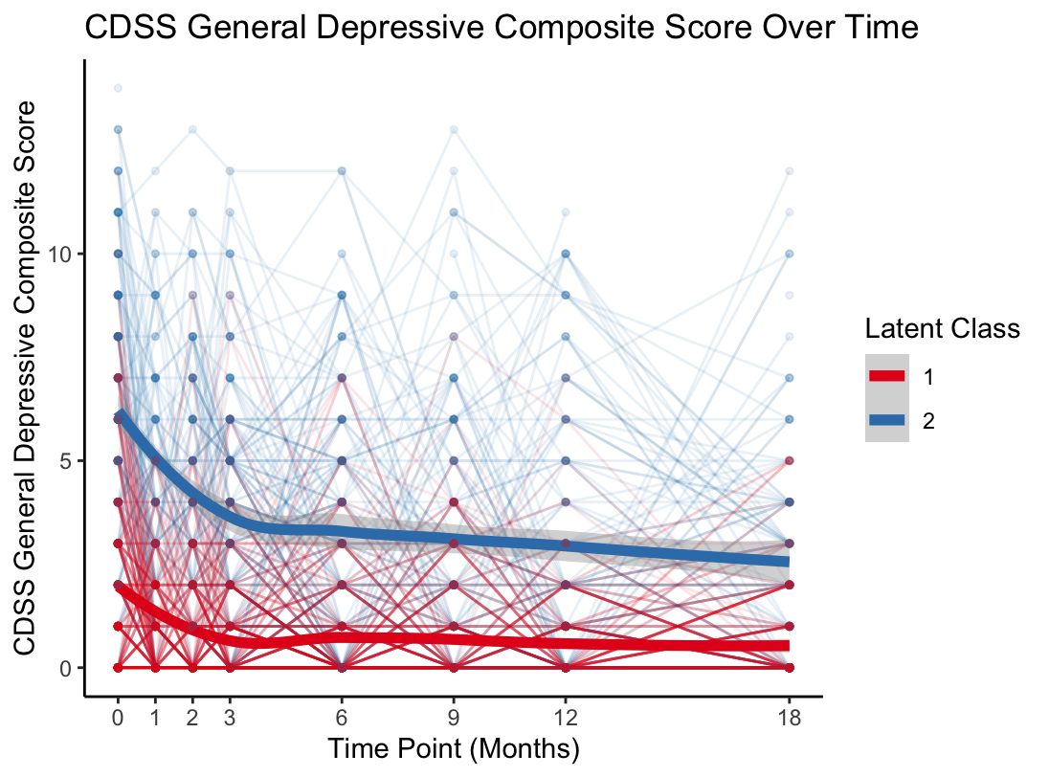
Note: 2-class, GMM2 of Total LV1 (up to 24 months) [LEFT] and (up to 18 months) [RIGHT]
Persistent low = 67%; decreasing = 33%

Slide 23
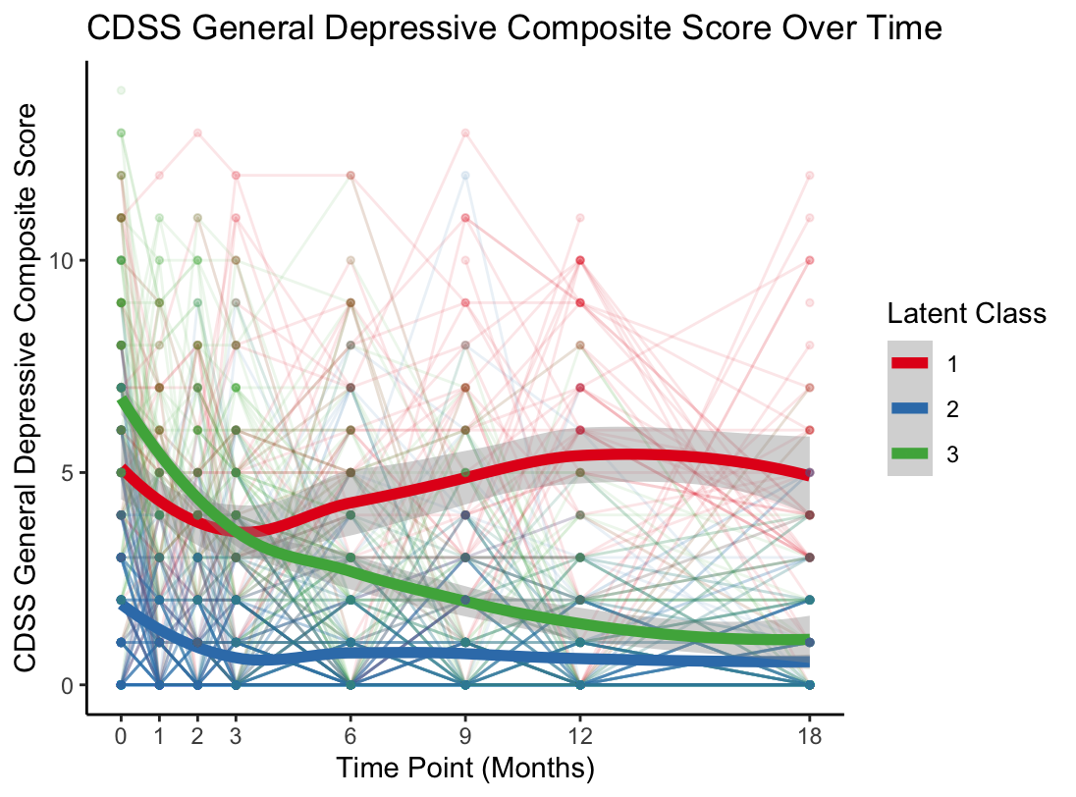
Note: 3-class, GMM2 of Total LV1 (up to 24 months ) [LEFT] and (up to 18 months) [RIGHT]
Fluctuating high = 2% (24mo)/10%(18mo); persistent low = 66%; decreasing = 32% (24mo)/23% (18mo)

Slide 24
CDSS [3-class solution is preferred]
Classes | BIC | sE | APP Class 1 | APP Class 2 | APP Class 3 | Observed BLRT | p-value
2 | 19072.05 | 0.6481 | 0.9052542 | 0.9058224 | / | 1928.931 3-class > 2-class | p < 0.002
3 | 19069.26 | 0.6609 | 0.8248774 | 0.8865396 | 0.7748834
Notes:
Note:
LV1: 3-class solution had a lower BIC for 24 months.

Slide 25
LV1 [3-class solution is preferred]
Classes | BIC | sE | APP Class 1 | APP Class 2 | APP Class 3 | Observed BLRT | p-value
2 | 16530.06 | 0.6699 | 0.9088892 | 0.9183974 | / | 2032.656 3-class > 2-class | p < 0.002
3 | 16534.00 | 0.6825 | 0.8357704 | 0.8931911 | 0.7996647
Notes:
Note:
LV1: 3-class solution had a lower BIC for 24 months.

Slide 26
SANS [2-class solution is preferred]
Classes | BIC | sE | APP Class 1 | APP Class 2 | APP Class 3 | Observed BLRT | p-value
2 | 20207.49 | 0.5401 | 0.8255826 | 0.8724210 | / | 288.2566 3-class > 2-class | p < 0.002
3 | 20214.53 | 0.4906 | 0.6621976 | 0.8013345 | 0.7416395
Notes:
Note:
LV1: 3-class solution had a lower BIC for 24 months.

Slide 27
Class Membership

Slide 28
Class membership (CDSS 3-class vs SANS 2-class - Top) (LV1 3-class vs SANS 2-class - Middle) (CDSS 3-class vs LV1 3-class - Bottom)
 |  | CDSS
 |  | 1 - Fluctuating High | 2 - Persistent Low | 3 - Decreasing | Total count
SANS | 1 - Persistent High | 28 (4.59%) | 114 (18.69%) | 37 (6.07%) | 179 (29.34%)
 | 2 - Decreasing | 26 (4.26%) | 293 (48.03%) | 112 (18.36%) | 431 (70.66%)
 | Total count | 54 (8.85%) | 407 (66.72%) | 149 (24.43%) | 610 (100.00%)
 |  | LV1
 |  | 1 - Fluctuating High | 2 - Persistent Low | 3 - Decreasing | Total count
SANS | 1 - Persistent High | 33 (5.41%) | 121 (19.84%) | 25 (4.1%) | 179 (29.34%)
 | 2 - Decreasing | 27 (4.43%) | 289 (47.38%) | 115 (18.85%) | 431 (70.66%)
 | Total count | 60 (9.84%) | 410 (67.21%) | 140 (22.95%) | 610 (100.00%)
 |  | CDSS
 |  | 1 - Fluctuating High | 2 - Persistent Low | 3 - Decreasing | Total count
LV1 | 1 - Fluctuating High | 46 (7.53%) | 5 (0.82%) | 9 (1.47%) | 60 (9.82%)
 | 2 - Persistent Low | 0 (0.00%) | 386 (63.18%) | 25 (4.09%) | 411 (67.27%)
 | 3 - Decreasing | 8 (1.31%) | 17 (2.78%) | 115 (18.82%) | 149 (24.39%)
 | Total count | 54 (8.84%) | 408 (66.78%) | 149 (24.39%) | 611 (100.00%)

Slide 29
Class membership (CDSS - Top; LV1 - Middle; and SANS - Bottom vs Social and Occupational Functioning Assessment Scale)
 |  | CDSS
 |  | 1 - Fluctuating High | 2 - Persistent Low | 3 - Decreasing | Total count
SOFAS | 1 - Low Functioning | 20 (4.83%) | 93 (22.46%) | 35 (8.45%) | 148 (35.75%)
 | 2 - High Functioning | 20 (4.83%) | 186 (44.93%) | 60 (14.49%) | 266 (64.25%)
 | Total count | 40 (9.66%) | 279 (67.39%) | 95 (22.95%) | 414 (100.00%)
 |  | LV1
 |  | 1 - Fluctuating High | 2 - Persistent Low | 3 - Decreasing | Total count
SOFAS | 1 - Low Functioning | 21 (5.07%) | 96 (23.19%) | 31 (7.49%) | 148 (35.75%)
 | 2 - High Functioning | 23 (5.56%) | 187 (45.17%) | 56 (13.53%) | 266 (64.25%)
 | Total count | 44 (10.63%) | 283 (68.36%) | 87 (21.01%) | 414 (100.00%)
 |  | SANS
 |  | 1 - Persistent High | 2 - Decreasing | Total count
SOFAS | 1 - Low Functioning | 84 (19.49%) | 72 (16.71%) | 156 (36.19%)
 | 2 - High Functioning | 40 (9.28%) | 235 (54.52%) | 275 (63.81%)
 | Total count | 124 (28.77%) | 307 (71.23%) | 431 (100.00%)

Slide 30
Logistic Regression: SOFAS_24 as Outcome

Slide 31
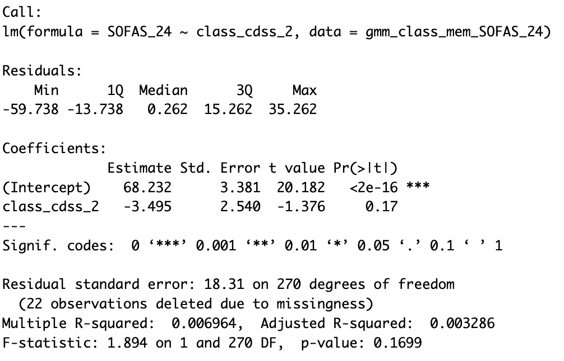
CDSS 2-class (n=271)
Mean SOFAS_24 of class 1: 68.232. On average, SOFAS_24 of class 2 is 3.495 lower than class 1
β = -3.495, p = 0.17 (not stat. sig.)
Large residual standard error: 18.31
Only 0.6964% of the variance in SOFAS_24 is explained by CDSS class membership
Conclusion: limited predictive value of CDSS 2-class trajectories alone on SOFAS functioning at 24 months

Slide 32
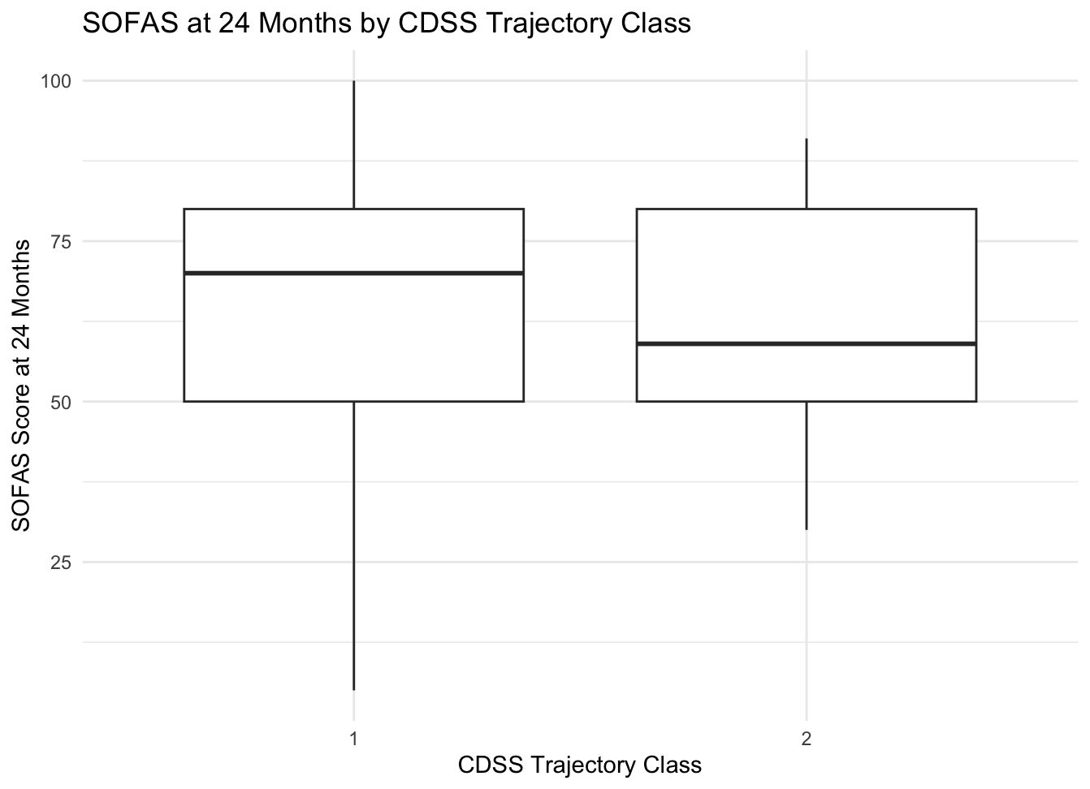
1 - Persistent Low
2 - Decreasing

Slide 33
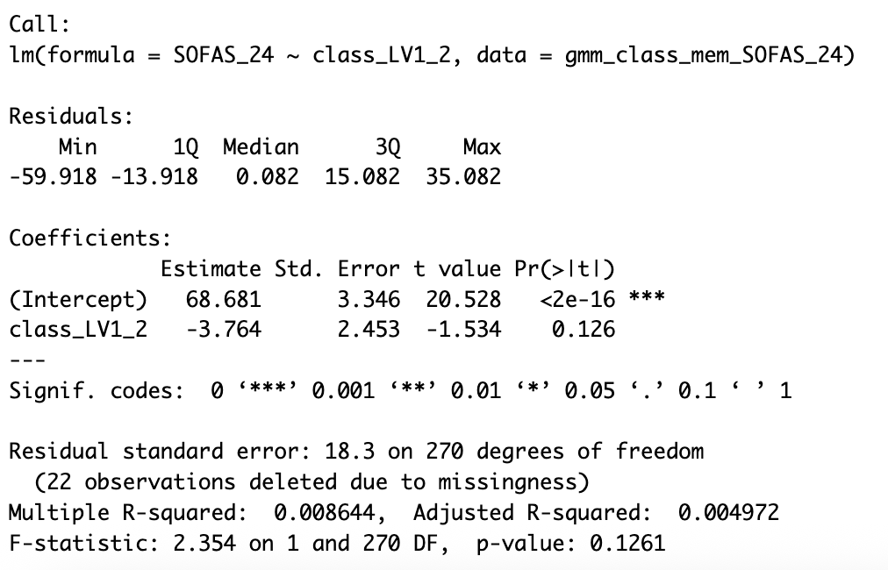
LV1 2-class (n=271)
Mean SOFAS_24 of class 1: 68.681. On average, SOFAS_24 of class 2 is 3.764 lower than class 1
β = -3.764, p = 0.126 (not stat. sig.)
Large residual standard error: 18.3
Only 0.8644% of the variance in SOFAS_24 is explained by LV1 class membership
Conclusion: limited predictive value of LV1 2-class trajectories alone on SOFAS functioning at 24 months

Slide 34
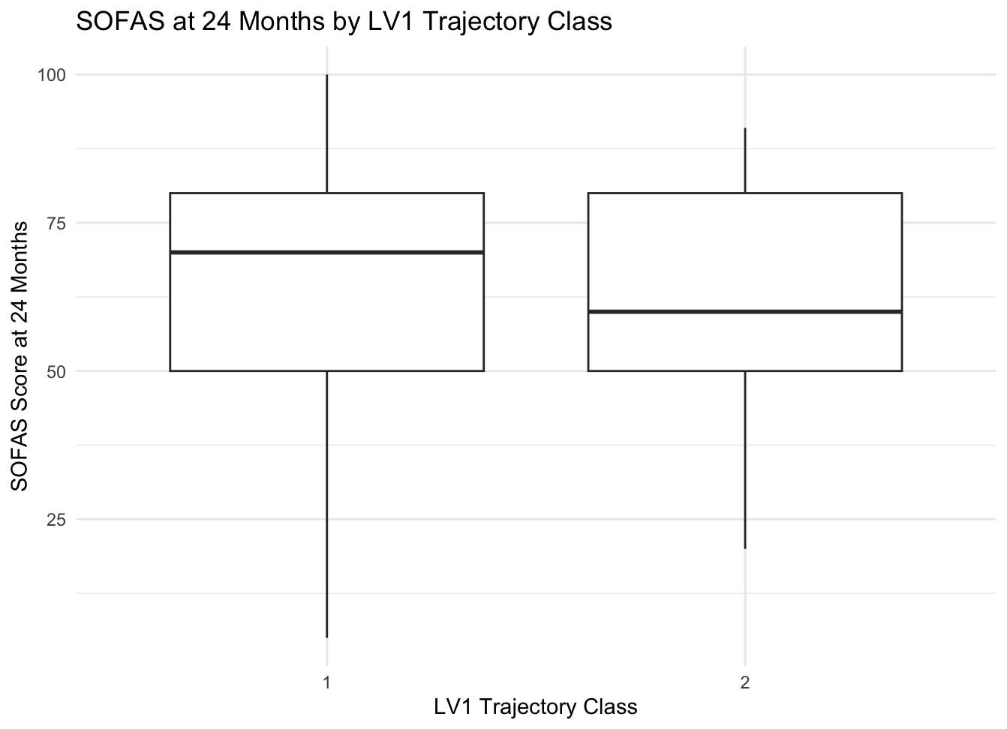
1 - Persistent Low
2 - Decreasing

Slide 35
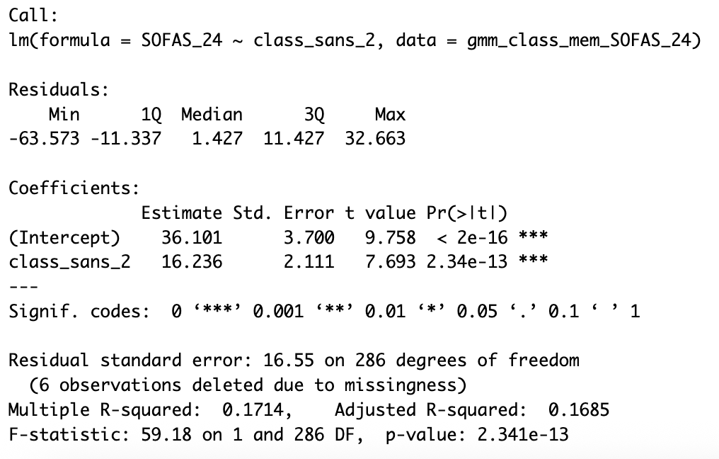
SANS 2-class (n=287)
Mean SOFAS_24 of class 1: 36.101. On average, SOFAS_24 of class 2 is 16.236 lower than class 1
β = 16.236, p < .001 (stat. sig.)
Residual standard error: 16.55
17.14% of the variance in SOFAS_24 is explained by SANS class membership
Conclusion: Class 2 SANS trajectory group had significantly higher SOFAS score at 24 months compared to those in class 1. The difference was statistically significant (β = 16.236, p < 0.001) and explained approximately 17% of the variance in functioning outcomes.

Slide 36
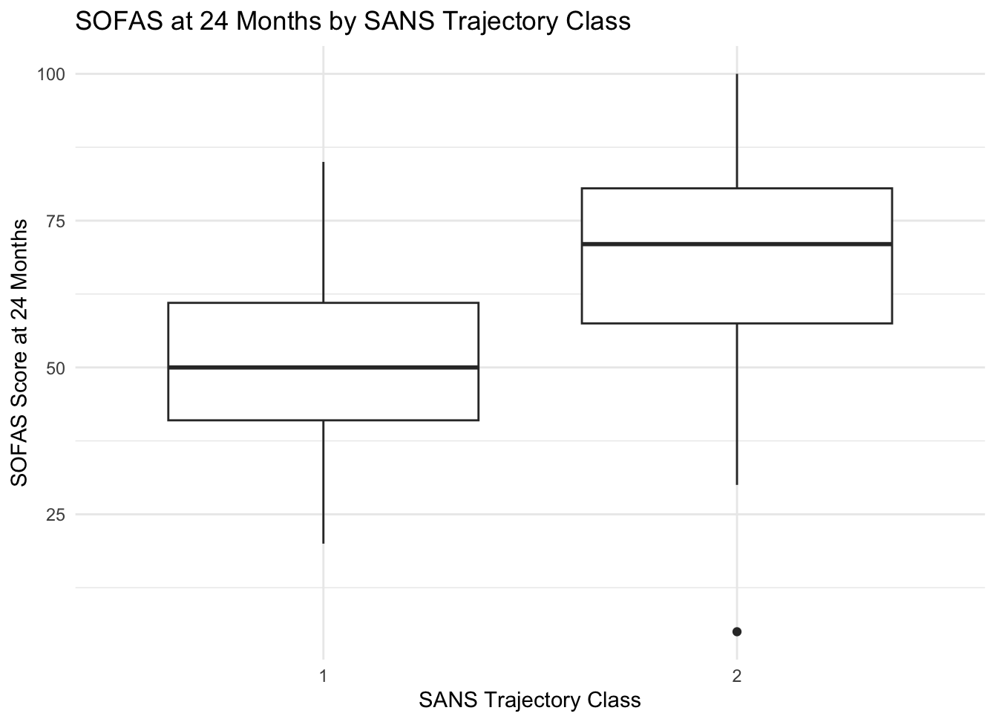
1 - Persistent High
2 - Decreasing

Slide 37
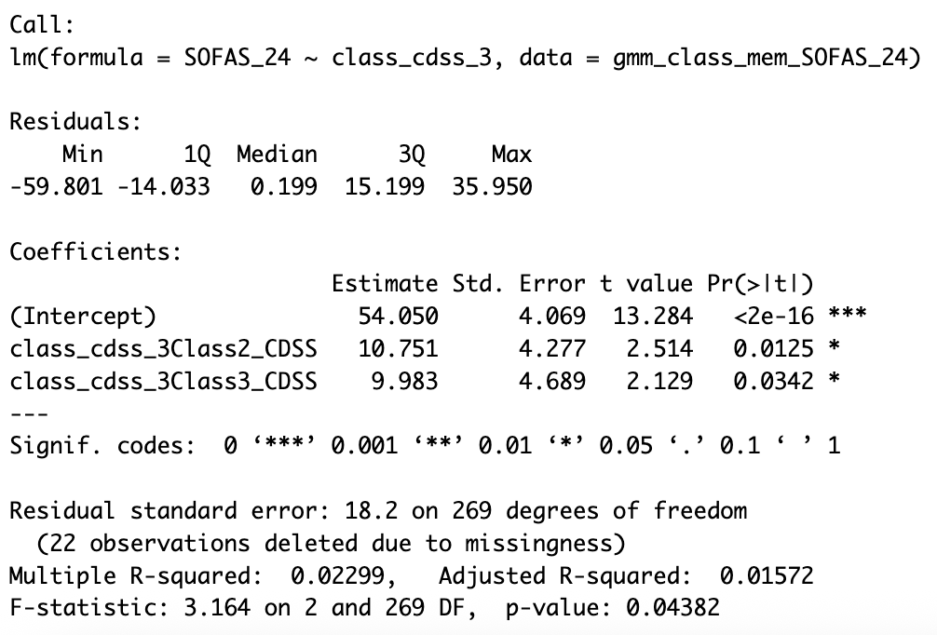
CDSS 3-class (n=270)
Mean SOFAS_24 of class 1 (fluctuating high): 54.05. On average, SOFAS_24 of class 2 (persistent low) and class 3 (decreasing) is 10.751 and 9.983 higher than class 1, respectively
β = 18.2, p = 0.044 (stat. sig.)
2.299% of the variance in SOFAS_24 is explained by CDSS class membership
Conclusion: Class 2 and 3 CDSS trajectory group had significantly higher SOFAS score at 24 months compared to those in class 1.

Slide 38
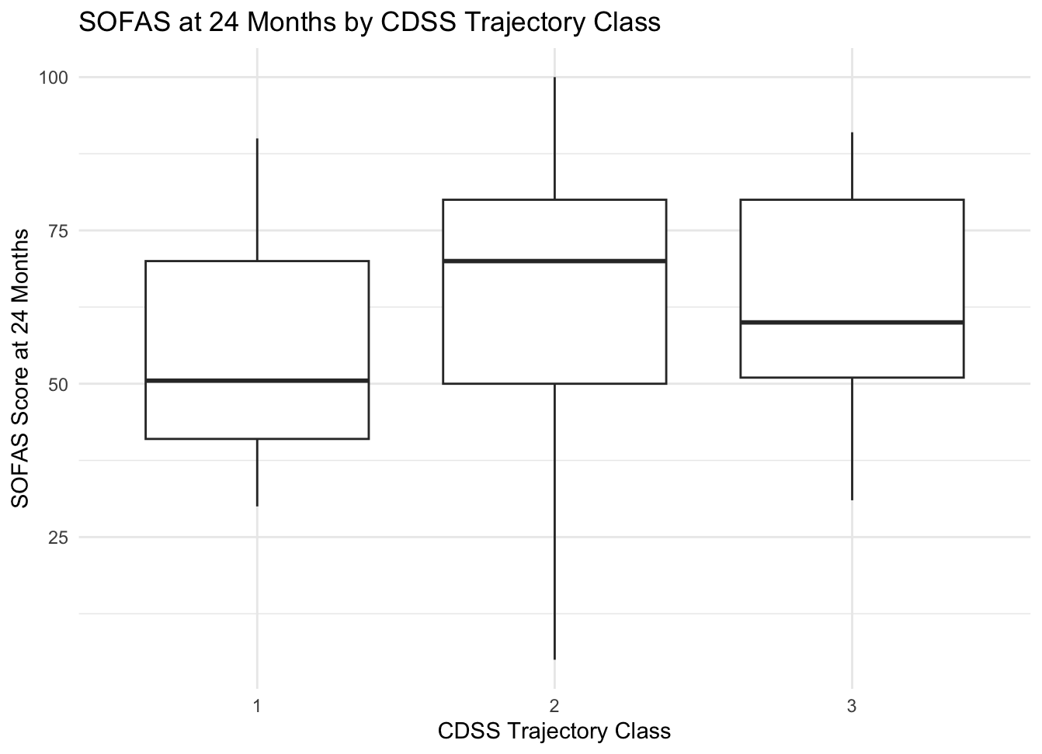
1 - Fluctuating High
2 - Persistent Low
3 - Decreasing

Slide 39
CDSS Post Hoc
CDSS Class | Adjusted Mean | 95% CI | SE
1 - Fluctuating High | 54.0 | [46.0, 62.1] | 4.07
2 - Persistent Low | 64.8 | [62.2, 67.4] | 1.32
3 - Decreasing | 64.0 | [59.4, 68.6] | 2.33
Class Comparison | Estimate | p-value | Interpretation
Class 1 - Class 2 | -10.751 | 0.0334 | Class 2 scored significantly higher SOFAS at 24 months (10.751) than Class 1
Class 1 - Class 3 | -9.983 | 0.0859 | Class 3 scored higher SOFAS at 24 months (9.983) than Class 1, but not statistically significant.
Class 2 - Class 3 | 0.768 | 0.9556 | No significant difference between Class 2 and Class 3

Slide 40
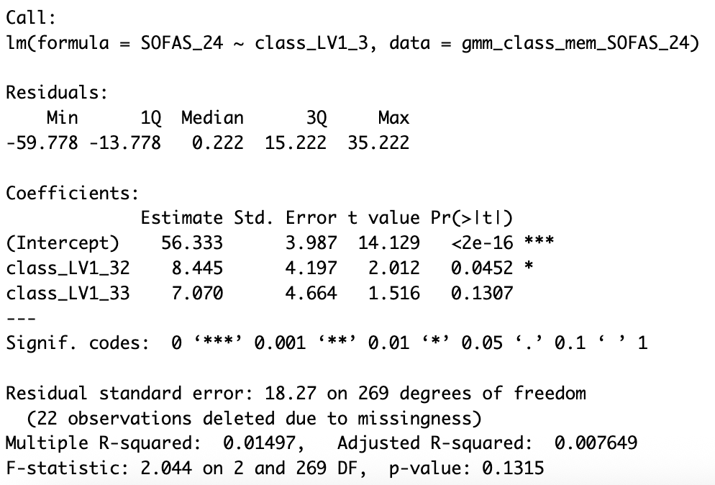
LV1 3-class (n=270)
Mean SOFAS_24 of class 1 (fluctuating high): 56.33. On average, SOFAS_24 of class 2 (persistent low) and class 3 (decreasing) is 8.445 and 7.070 higher than class 1, respectively
β = 18.27, p < 0.045 (stat. sig.) for class 1 vs class 2
1.497% of the variance in SOFAS_24 is explained by LV1 class membership
Conclusion: Class 2 LV1 trajectory group had significantly higher SOFAS score at 24 months compared to those in class 1.

Slide 41
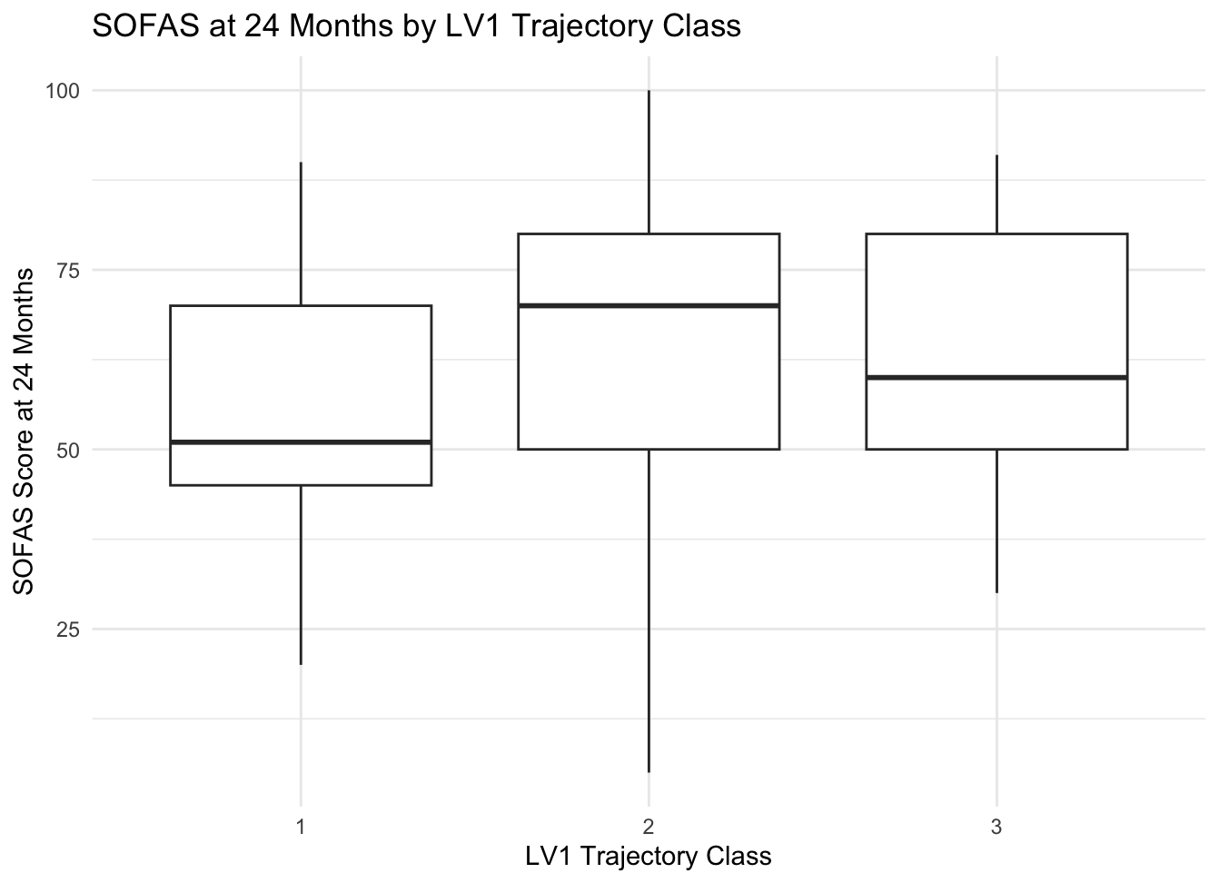
1 - Fluctuating High
2 - Persistent Low
3 - Decreasing

Slide 42
LV1 Post Hoc
LV1 Class | Adjusted Mean | 95% CI | SE
1 - Fluctuating High | 56.3 | [48.5, 64.2] | 3.99
2 - Persistent Low | 64.8 | [62.2, 67.4] | 1.31
3 - Decreasing | 63.4 | [58.6, 68.2] | 2.42
Class Comparison | Estimate | p-value | Interpretation
Class 1 - Class 2 | -8.45 | 0.1113 | Class 2 scored higher SOFAS at 24 months (8.45) than Class 1, but not statistically significant
Class 1 - Class 3 | -7.07 | 0.2851 | Class 3 scored higher SOFAS at 24 months (7.07) than Class 1, but not statistically significant
Class 2 - Class 3 | 1.37 | 0.8716 | No significant difference between Class 2 and Class 3

Slide 43
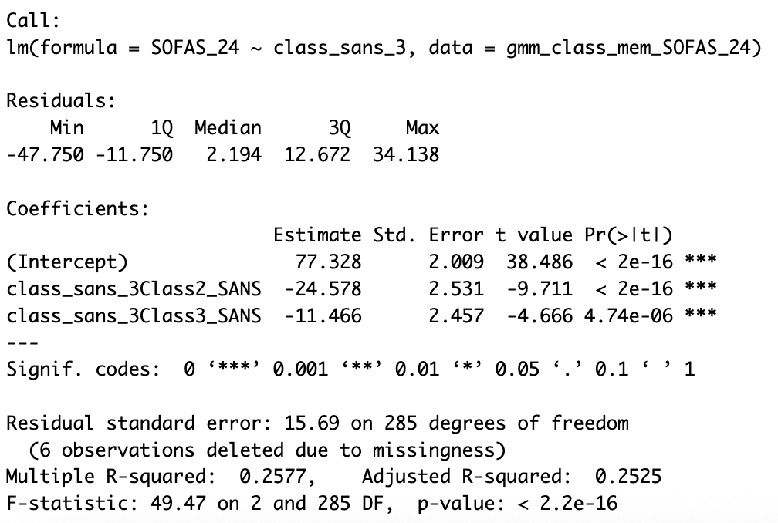
SANS 3-class (n=286)
Mean SOFAS_24 of class 1 (decrease & sustained): 77.328. On average, SOFAS_24 of class 2 (persistent high) and class 3 (gradual decrease) is 24.578 and 11.466 lower than class 1, respectively
β = 15.69, p < .001 (stat. sig.) for both
2.577% of the variance in SOFAS_24 is explained by SANS class membership
Conclusion: Class 2 and 3 SANS trajectory group had significantly higher SOFAS score at 24 months compared to those in class 1.

Slide 44
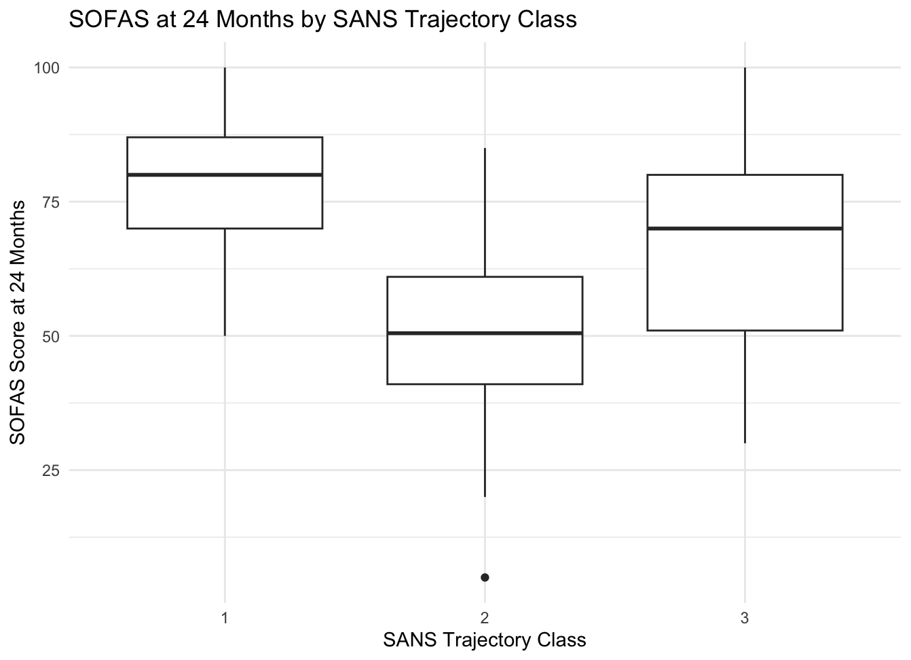
1 - Decrease & Sustained
2 - Persistent High
3 - Gradual Decreasing

Slide 45
SANS Post Hoc
SANS Class | Adjusted Mean | 95% CI | SE
1 - Decrease/Sustained | 77.3 | [73.4, 81.3] | 2.01
2 - Persistent High | 52.8 | [49.7, 55.8] | 1.54
3 - Gradual Decrease | 65.9 | [63.1, 68.6] | 1.41
Class Comparison | Estimate | p-value | Interpretation
Class 1 - Class 2 | 24.6 | <.0001 | Class 2 scored significantly lower SOFAS at 24 months (24.6) than Class 1
Class 1 - Class 3 | 11.5 | <.0001 | Class 3 scored significantly lower SOFAS at 24 months (11.5) than Class 1
Class 2 - Class 3 | -13.1 | <.0001 | Class 3 scored significantly higher SOFAS at 24 months (13.1) than Class 2

Slide 46
Logistic Regression: SOFAS_0 as Predictor
Option 1: Multinomial Logistic Regression

Slide 47
MLR - CDSS (n=554)
Comparison | Odds Ratio | SOFAS_0 Coefficient | p-value
2-class CDSS
2 - Decreasing vs 1 - Persistent Low | 0.99459 | -0.005425386 | 0.475
3-class CDSS
2 - Persistent Low vs 1- Fluctuating High | 1.001278 | 0.001277669 | 0.916
3 - Decreasing vs 1- Fluctuating High | 1.001398 | 0.001396598 | 0.916
Baseline SOFAS score is not a significant predictor of latent class membership
Odds ratios very close to 1
Changes in SOFAS_0 score lead to nearly no changes in class membership

Slide 48
MLR - LV1 (n=554)
Comparison | Odds Ratio | SOFAS_0 Coefficient | p-value
2-class LV1
2 - Decreasing vs 1 - Persistent Low | 1.0008995 | 0.0008990553 | 0.904
3-class LV1
2 - Persistent Low vs 1- Fluctuating High | 1.002013 | 0.0020107726 | 0.859
3 - Decreasing vs 1- Fluctuating High | 1.000754 | 0.0007538932 | 0.954
Baseline SOFAS score is not a significant predictor of latent class membership
Odds ratios very close to 1
Changes in SOFAS_0 score lead to nearly no changes in class membership

Slide 49
MLR - SANS (n=574)
Comparison | Odds Ratio | SOFAS_0 Coefficient | p-value
2-class SANS
2- Decreasing vs 1- Persistent High | 1.0271190 | 0.02675779 | 0.001
3-class SANS
2- Persistent High vs 1- Decrease/Sustained | 0.9571937 | -0.04374952 | < 0.001
3- Gradual Decrease vs 1- Decrease/Sustained | 0.9627766 | -0.03793385 | < 0.001
Baseline SOFAS score IS a significant predictor of latent class membership (2-class and 3-class)
Higher SOFAS reduces the odds of being in either 2 - Persistent High or 3 - Gradual Decrease (each 1-point increase in SOFAS_0 = 4.3% lower odds of being in 2 - Persistent High; 3.7% lower odds in 3 - Gradual Decrease)

Slide 50
Logistic Regression: SOFAS_0 as Predictor
Option 2: Conditional GMM with SOFAS_0 as covariate

Slide 51
cGMM - CDSS (n=554)
Comparison | SOFAS_0 Coefficient | p-value
2-class CDSS
Class 1 vs Class 2 | 0.00318 | 0.701
3-class CDSS
Class 1 vs Class 3 | 0.00233 | 0.792
Class 2 vs Class 3 | -0.00271 | 0.904
Baseline SOFAS score is not a significant predictor of latent class membership
Negligible SOFAS_0 coefficients (class membership likely will not change with SOFAS_0)

Slide 52
cGMM - LV1 (n=554)
Comparison | SOFAS_0 Coefficient | p-value
2-class LV1
Class 1 vs Class 2 | 0.00244 | 0.762
3-class LV1
Class 1 vs Class 3 | -0.04157 | 0.242
Class 2 vs Class 3 | -0.00019 | 0.981
Baseline SOFAS score is not a significant predictor of latent class membership
Negligible SOFAS_0 coefficients (class membership likely will not change with SOFAS_0)

Slide 53
cGMM - SANS (n=574)
Comparison | SOFAS_0 Coefficient | p-value
2-class SANS
Class 1 vs Class 2 | -0.22511 | 0.138
3-class SANS
Class 1 vs Class 3 | -0.40416 | 0.01950
Class 2 vs Class 3 | -0.05637 | 0.094
Baseline SOFAS score is not a significant predictor of latent class membership for 2-class SANS or class 2 vs class 3 SANS. However, it is a significant predictor of class 1 vs class 3 SANS (p=0.020).
Negligible SOFAS_0 coefficients (class membership likely will not change with SOFAS_0) for classes 2 and 3.

Slide 54
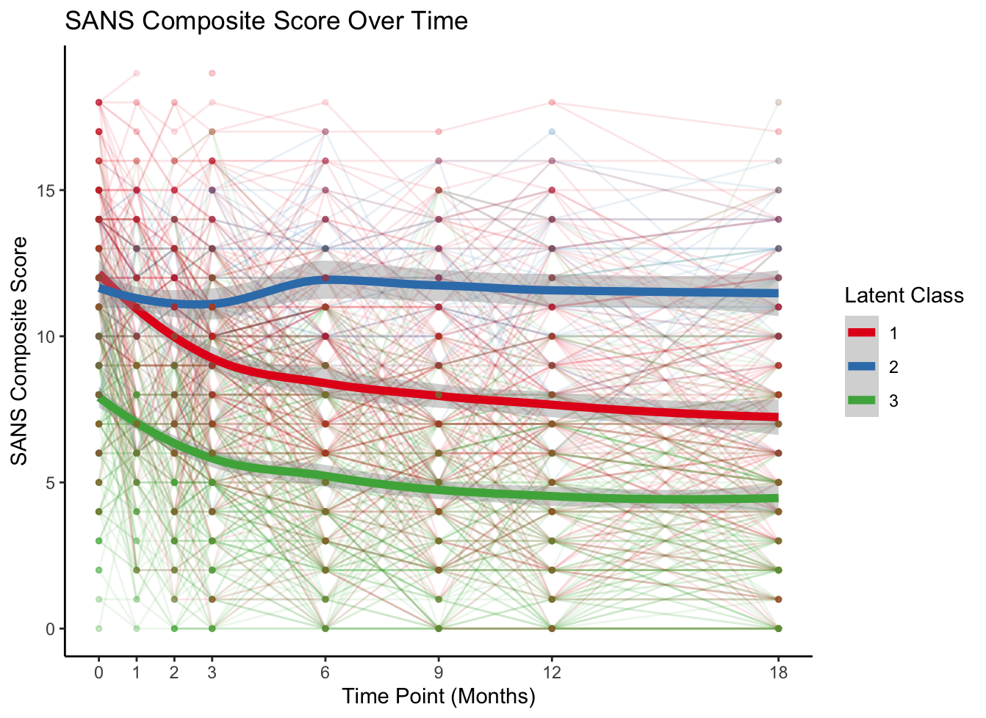
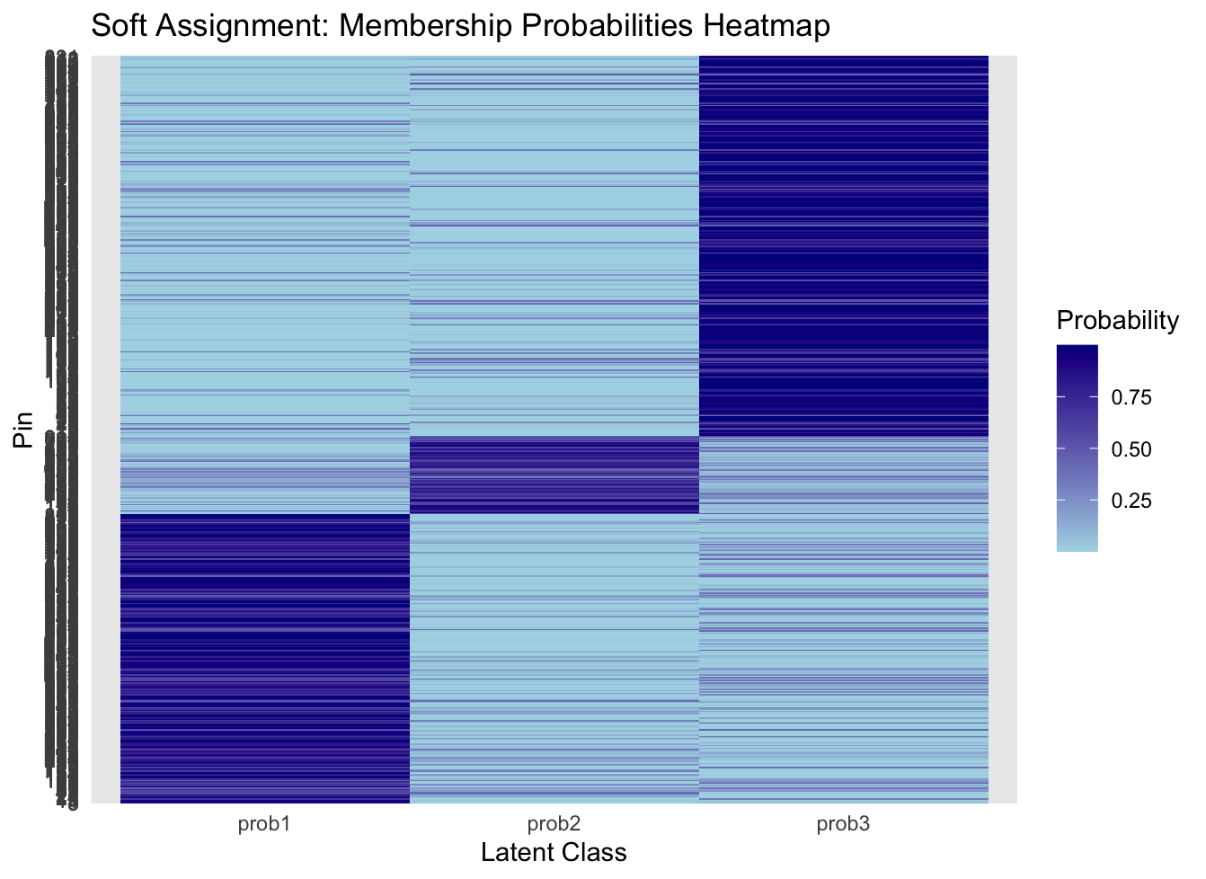

Slide 55
Logistic Regression: CPZ_0 as Predictor
Note: cGMMs could not generate classes

Slide 56
MLR - CDSS (n=554)
Comparison | Odds Ratio | CPZ_0 Coefficient | p-value
2-class CDSS
2 - Decreasing vs 1 - Persistent Low | 0.9999979 | -2.138913e-06 | 0.996
3-class CDSS
2 - Persistent Low vs 1- Fluctuating High | 1.000362 | 0.0003623633 | 0.690
3 - Decreasing vs 1- Fluctuating High | 1.000371 | 0.0003707141 | 0.707
Baseline CPZ is not a significant predictor of latent class membership
Odds ratios very close to 1
Changes in CPZ_0 lead to nearly no changes in class membership

Slide 57
MLR - LV1 (n=554)
Comparison | Odds Ratio | CPZ_0 Coefficient | p-value
2-class LV1
2 - Decreasing vs 1 - Persistent Low | 0.999802 | -0.0001979743 | 0.710
3-class LV1
2 - Persistent Low vs 1- Fluctuating High | 0.9995434 | -0.0004566553 | 0.503
3 - Decreasing vs 1- Fluctuating High | 0.9989739 | -0.0010266015 | 0.240
Baseline CPZ is not a significant predictor of latent class membership
Odds ratios very close to 1
Changes in CPZ_0 lead to nearly no changes in class membership

Slide 58
MLR - SANS (n=574)
Comparison | Odds Ratio | SOFAS_0 Coefficient | p-value
2-class SANS
2- Decreasing vs 1- Persistent High | 1.000228 | 0.0002278521 | 0.673
3-class SANS
2- Persistent High vs 1- Decrease/Sustained | 1.000879 | 0.0008782015 | 0.231
3- Gradual Decrease vs 1- Decrease/Sustained | 1.001121 | 0.0011198971 | 0.114
Baseline CPZ is not a significant predictor of latent class membership
Odds ratios very close to 1
Changes in CPZ_0 lead to nearly no changes in class membership

Slide 59
Appendix
See all class membership tables here
CDSS 2-class linear regression assumption check
LV1 2-class linear regression assumption check
SANS 2-class linear regression assumption check
CDSS 3-class linear regression assumption check
LV1 3-class linear regression assumption check
SANS 3-class linear regression assumption check

Slide 60
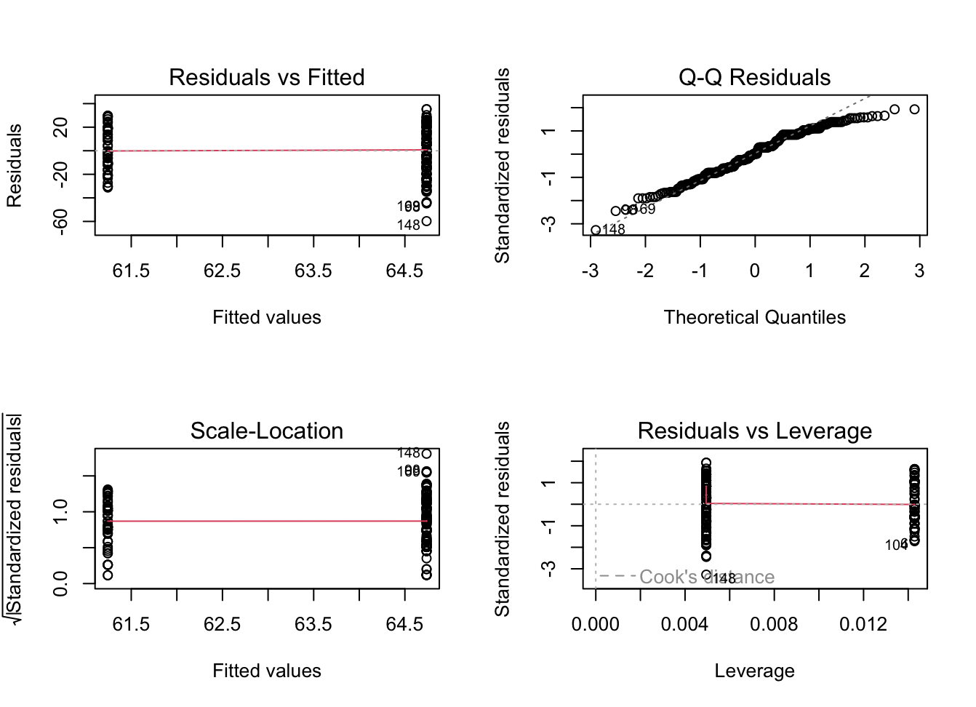
CDSS 2-class residual and normality assumption check [all good]

Slide 61
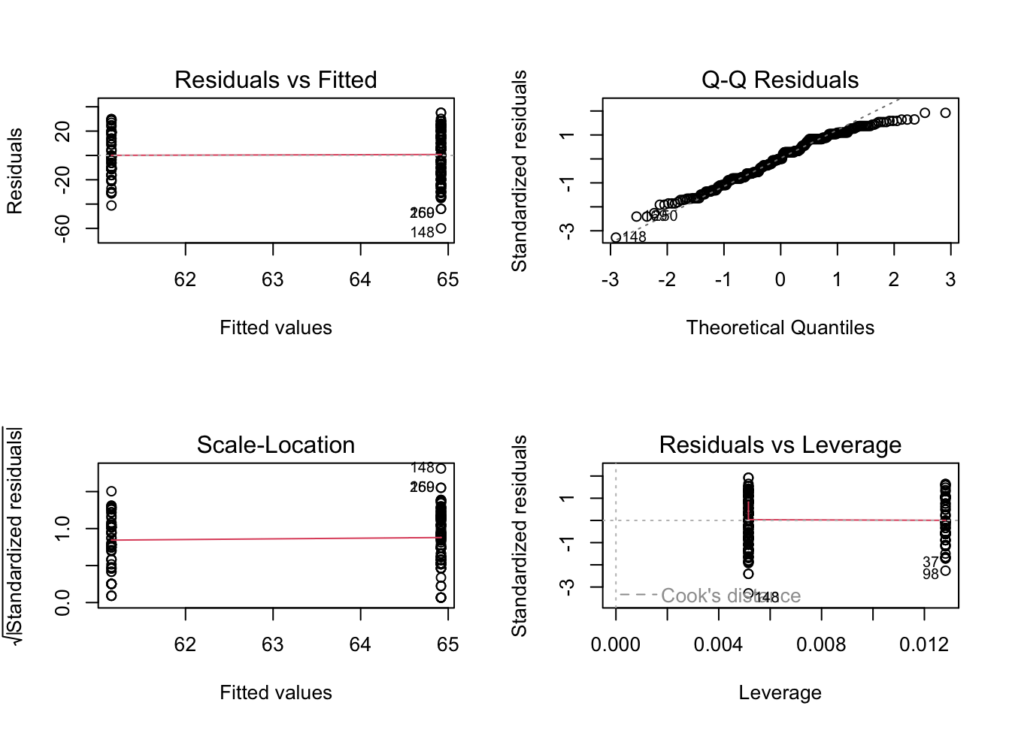
LV1 2-class residual and normality assumption check [all good]

Slide 62
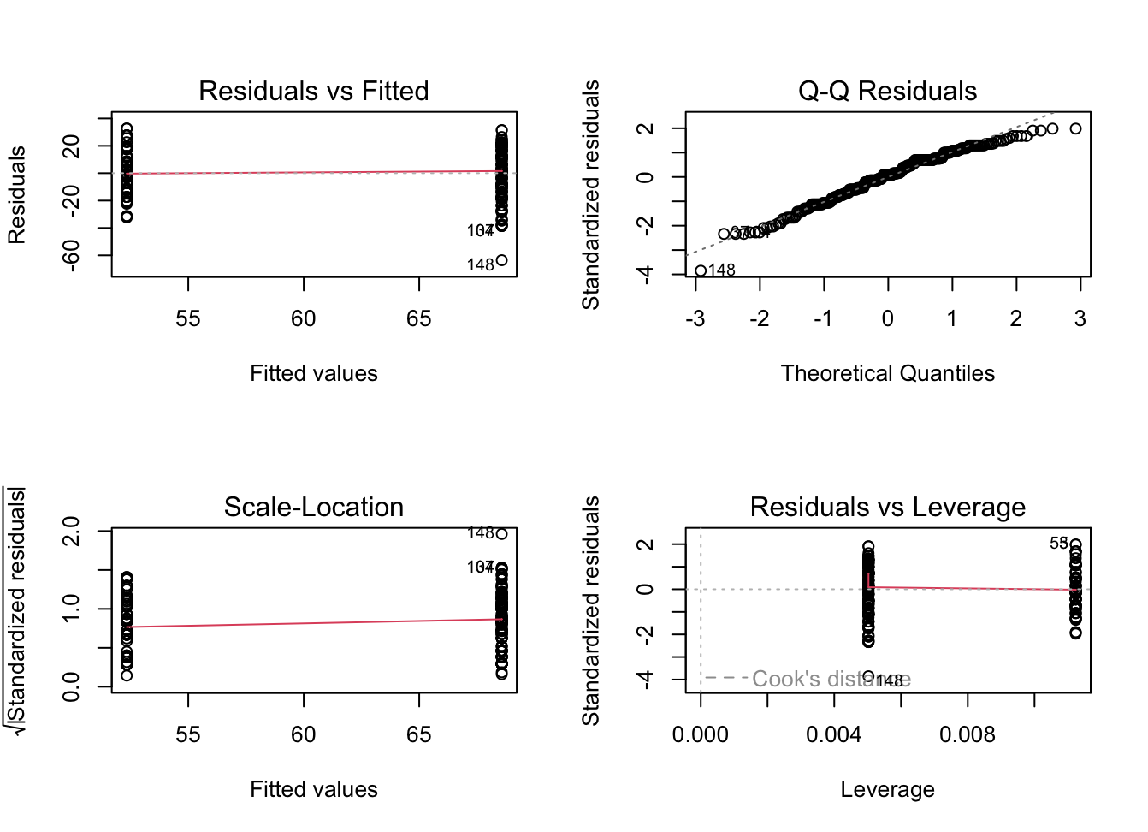
SANS 2-class residual and normality assumption check [all good]

Slide 63
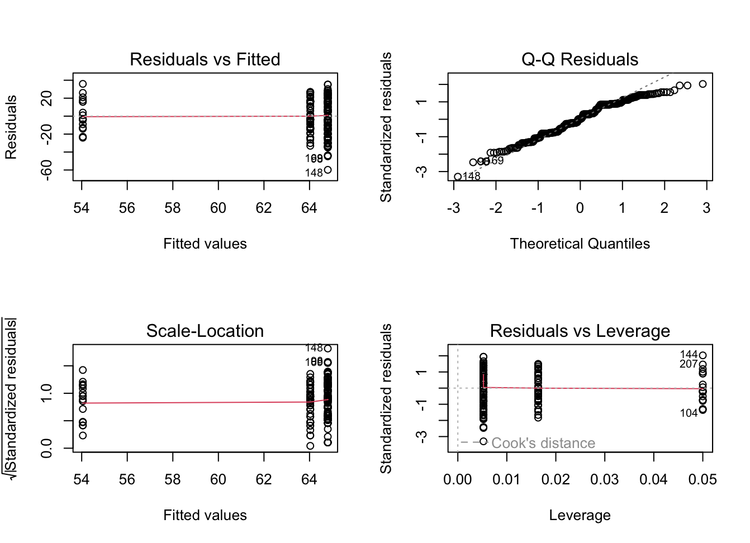
CDSS 3-class residual and normality assumption check [all good]

Slide 64
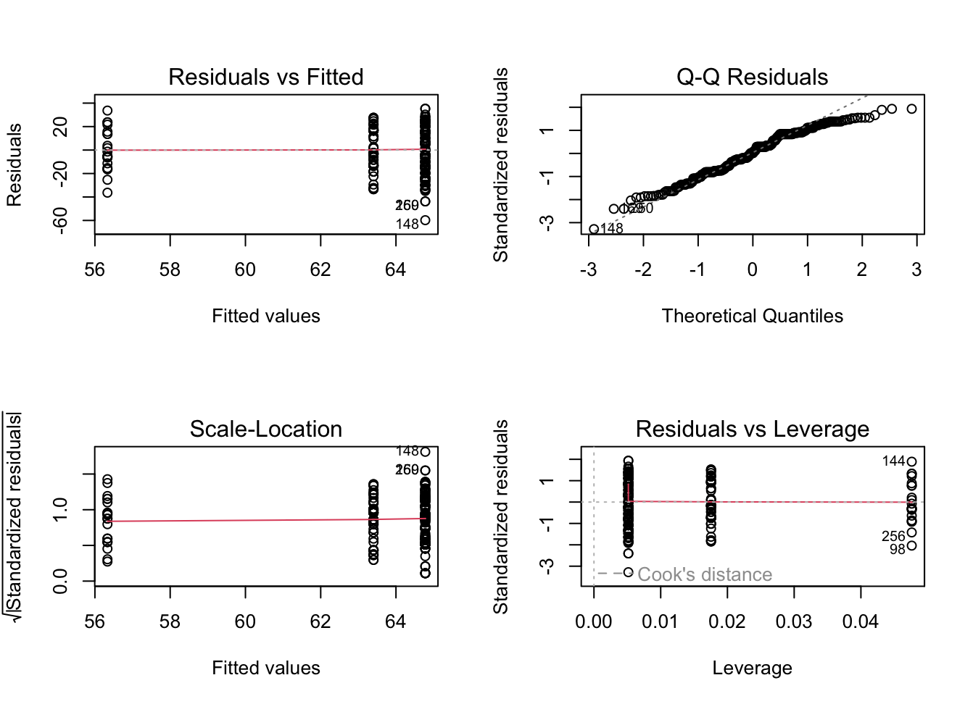
LV1 3-class residual and normality assumption check [all good]

Slide 65
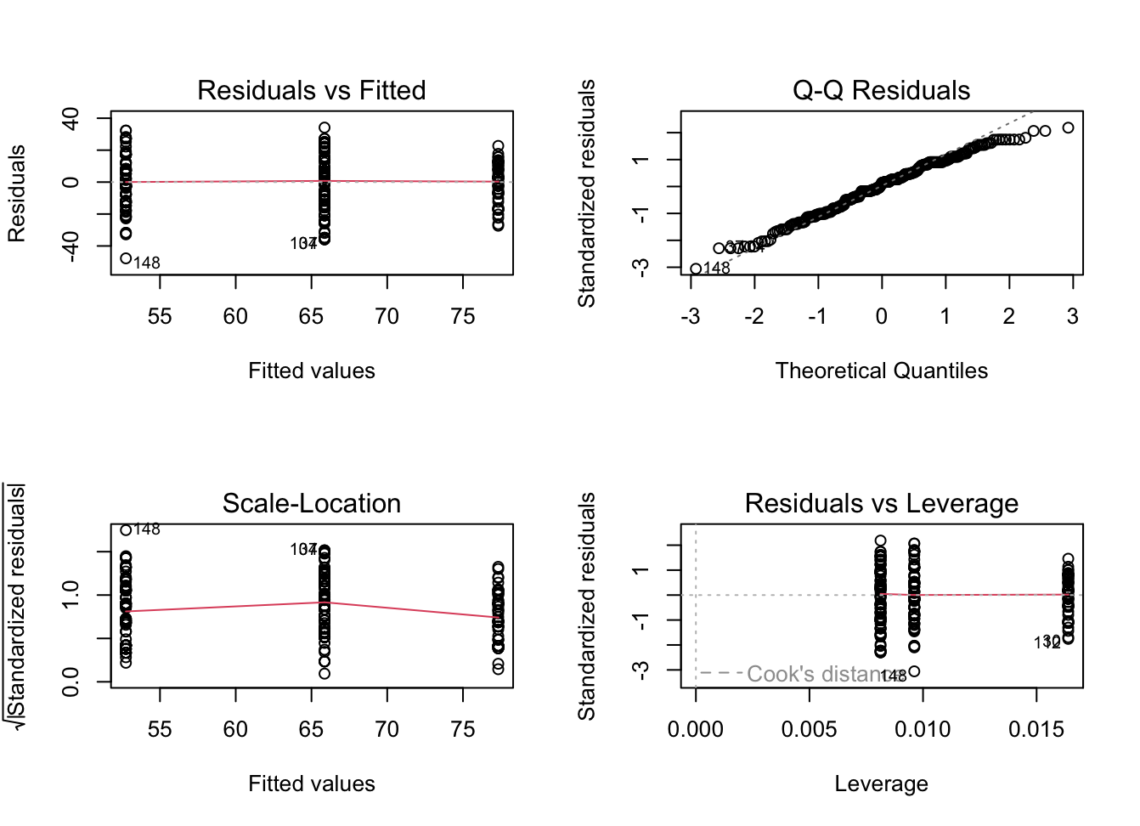
SANS 3-class residual and normality assumption check [all good]

